Slide 1
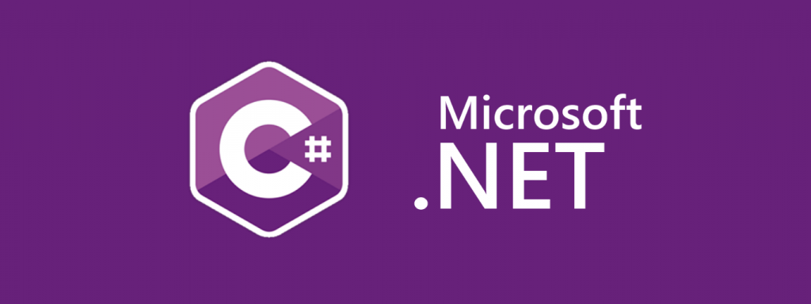
.Net Web Programming
Dr.Öğr.Üyesi Volkan ALTINTAŞ

Slide 2
Teams Code : ubutfj8
%40 Midterm
%60 Final
Resources : Internet

Slide 3
Week 1
Course introduction
Introduction to web programming
General overview of the .NET platform (.NET Framework, .NET Core, .NET 5/6/7)
Installation of Visual Studio / Visual Studio Code
Week 2
Review of basic C# (Variables, Data Types, Control Structures, Loops)
Introduction to OOP concepts (Class, Object, Inheritance, Polymorphism)
Week 3
Introduction to the ASP.NET Core MVC structure
Model-View-Controller (MVC) architecture
Creating the first MVC project
Week 4
Routing
Controller and Action methods
Basic page design with View (Razor Syntax)
Week 5
Model structure
Data validation
Form operations (GET/POST)

Slide 4
Week 6
Introduction to Entity Framework Core
Database First and Code First approaches
CRUD (Create, Read, Update, Delete) operations
Week 7
View Model and DTO concepts
Layout pages, Partial View
Integration of responsive design with Bootstrap
Week 8
Midterm Exam
Week 9
User management with ASP.NET Core Identity
Authentication & Authorization concepts
Login, Register, Logout operations
Week 10
Using Session and Cookie
Role-based authorization
Middleware structure

Slide 5
Week 11
Introduction to Web API
RESTful service logic
JSON data transfer
Week 12
CRUD operations with ASP.NET Core Web API
Using Postman
Frontend integration (consuming the API with JavaScript / AJAX)
Week 13
Project development work
Layered architecture (Business, Data, Presentation)
Using Dependency Injection (DI)
Week 14
General review
Q&A (Questions & Answers)

Slide 6
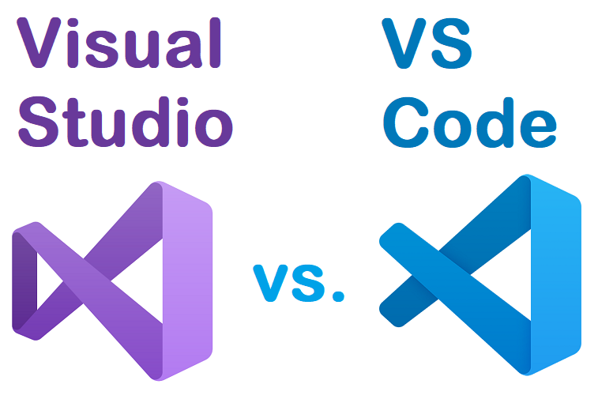
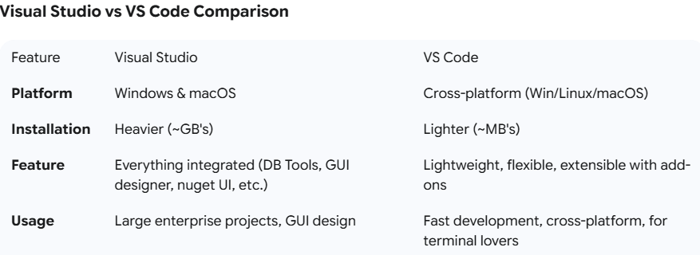

Slide 7
Introduction to Web Programming
What is the Web? (HTTP, client–server)
Client: Your browser (Chrome, Edge, Firefox) or a mobile application.
Server: A computer running somewhere on the internet; it has your application (ASP.NET Core) on it.
HTTP: The protocol used to carry messages (requests–responses) between the client and the server.
Request: Something like, "Give me the page for /products/5."
Response: Something like, "Here you go, here's the HTML content and these images..."

Slide 8
Introduction to Web Programming
HTTP Methods:
GET (fetch data)
POST (submit data)
PUT/PATCH (update)
DELETE (delete)

Slide 9
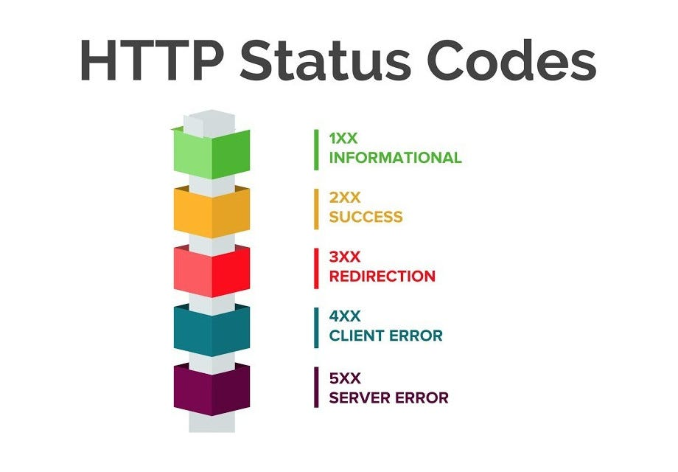
Introduction to Web Programming
Status Codes:
200 OK (success)
201 Created
400 Bad Request
401 Unauthorized
404 Not Found
500 Internal Server Error

Slide 10
Introduction to Web Programming
Static vs. Dynamic
Static Site: Delivers the same files (pure HTML/CSS) to every user.
Dynamic Application: Generates content based on the user or the request (e.g., "Welcome, Ayşe!"). This is where ASP.NET Core comes in.
Frontend vs. Backend
Frontend: The part that users see (HTML, CSS, JavaScript, React, Bootstrap).
Backend: Handles the business logic, data access, and authentication (ASP.NET Core, C#, EF Core).
Database: Used for permanent storage (SQL Server, PostgreSQL, MySQL).

Slide 11
A General Overview of the .NET Platform
.NET Framework vs. .NET Core vs. “.NET” (5/6/7/8)
.NET Framework: Older, Windows-only; still used in some enterprise projects.
.NET Core: Modern, cross-platform (Windows, macOS, Linux), high performance.
.NET 5+: The naming has now merged into just “.NET” (it’s a continuation of Core). LTS (Long-Term Support) versions are supported for a long time.

Slide 12
A General Overview of the .NET Platform
What is ASP.NET Core? Why do we use it?
It's high-performance, open-source, platform-independent, and has a modular architecture.
It allows you to develop web applications (MVC/Razor Pages), Web APIs, and real-time applications (SignalR).
It has a modern toolchain: dotnet CLI, NuGet packages, and powerful DI (Dependency Injection).

Slide 13
A General Overview of the .NET Platform
Where is it used?
Classic websites and corporate dashboards
RESTful APIs (consumed by mobile/web clients)
Microservices, background workers (Worker Service)
Desktop (WPF/WinForms) and mobile with MAUI

Slide 14
Development Environment
Tools
Visual Studio (Windows/macOS): A full-featured IDE (Integrated Development Environment).
Visual Studio Code: A lightweight editor that becomes powerful with the C# extension.
.NET SDK: Provides the dotnet commands (for compiling, running, and using templates).
Checking the Installation
dotnet --info
dotnet --version

Slide 15
Development Environment
Project Templates
MVC: A web application based on the Model-View-Controller pattern.
Razor: A web application based on Razor Pages.
Web API: A controller-based API.
Blazor (Server/WASM): An interactive UI using C#.

Slide 16
First Project
mkdir MyFirstApp
cd MyFirstApp
dotnet new mvc -n MyFirstApp
cd MyFirstApp
dotnet run

Slide 17
Common Initial Errors & Solutions
Port is in use: Another dotnet run might be active.
Close it or stop it with Ctrl+C.
HTTPS certificate warning: Trust the development certificate
by running dotnet dev-certs https --trust.
SDK not found: Check your PATH settings or reinstall the SDK.

Slide 18
Controllers: Handle the HTTP request, call the business logic, and return a View or JSON.
Models: Data-carrying classes; validation rules (DataAnnotations) are defined here.
Views: Razor .cshtml files; a mix of HTML and C#.
wwwroot: The root folder where static files are served.
appsettings.json: Configuration settings (connection strings, customizations).
Program.cs: Application startup (creating the host, adding services, middleware).
launchSettings.json: Defines debug profiles, environment variables, and URLs.

Slide 19
dotnet new console -n Ornekx
dotnet new console -n Ornek –-use-program-main

